Slide 1

Shark attacks
Presented by:
Andor Varsanyi

Slide 2
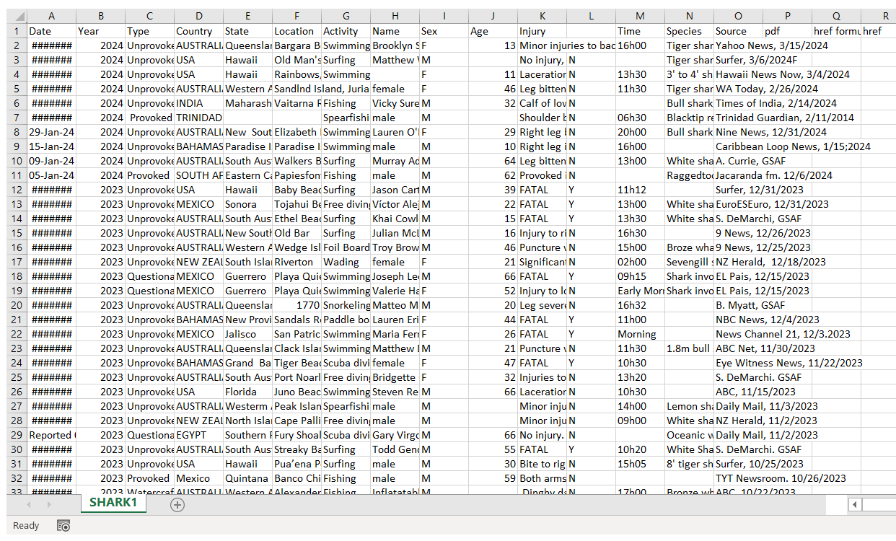
Original dataset
Highly inaccurate
Chaotic
Hypothesis: USA is leading

Slide 3
Process
Data import and exploration
Cleaning missing data
Standardize data
Pivot table analysis

Slide 4
Major obstacles
Converting the xls to csv
Problems with importing
Very huge, chaotic database

Slide 5
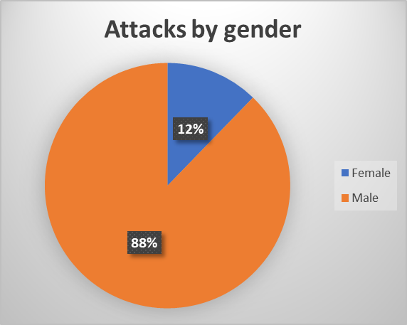

Slide 6
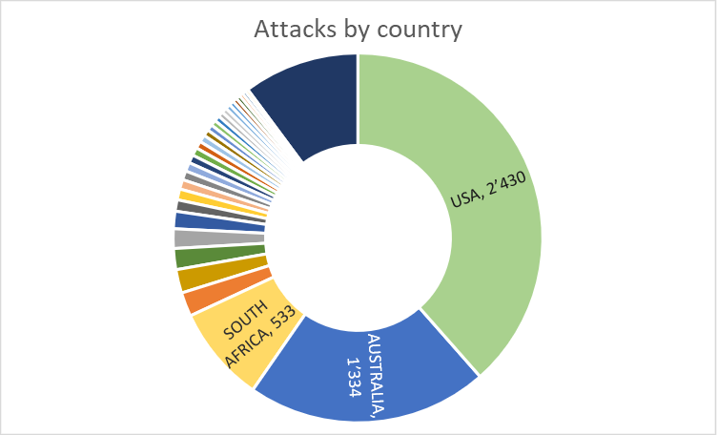

Slide 7
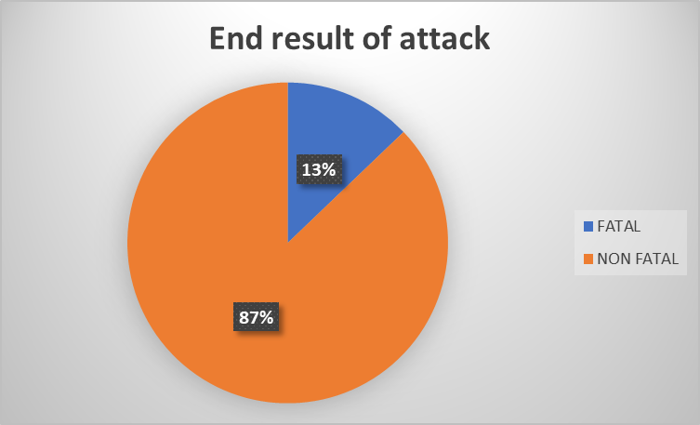

Slide 8
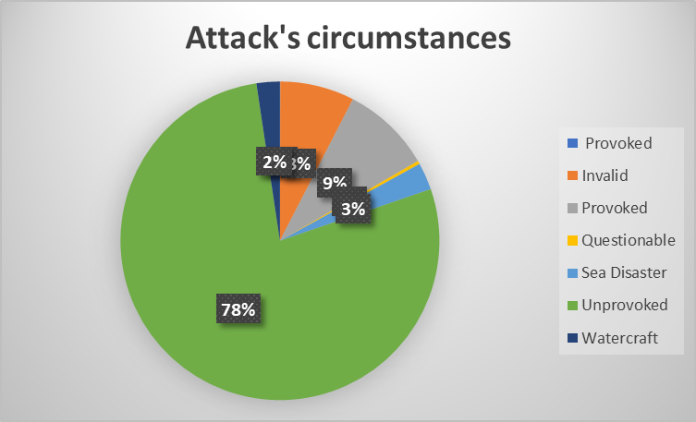

Slide 9
Thank you for your attention

